Slide 1

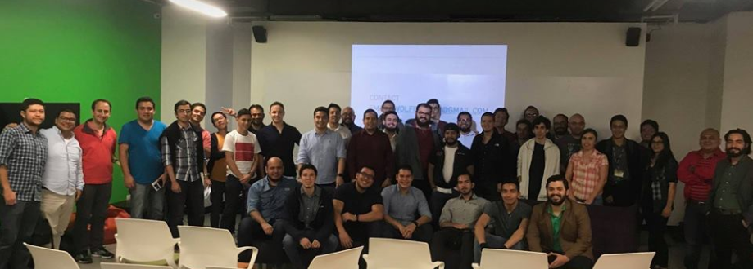
Software Testing Guatemala
Join us

Slide 2
Selenium Web Driver
Jerry Brian Osorio Alvarado
September, 2018

Slide 3
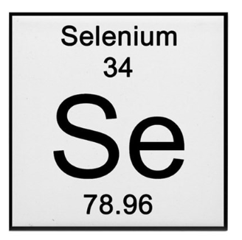
What is Selenium?

Slide 4
Selenium is a free (open source) automated testing suite for web applications across different browsers and platforms.

Slide 5

Selenium Backgrounds

Slide 6
Selenium was created by Jason Huggins
JavaScriptTestRunner (Selenium Core)
2004

Slide 7
Improvements of Selenium Core later become Selenium RC (Selenium 1)
JavaScriptTestRunner (Selenium Core)
2004
Selenium RC (Selenium 1)
2005

Slide 8
A Firefox extension that can automate the browser through a record-and-playback feature
JavaScriptTestRunner (Selenium Core)
2004
Selenium RC (Selenium 1)
2005
Selenium IDE 2006

Slide 9
Simon Stewart developed a superior browser automation tool called WebDriver
JavaScriptTestRunner (Selenium Core)
2004
Selenium RC (Selenium 1)
2005
Selenium IDE 2006
Web Driver 2006

Slide 10
Philippe Hanrigou, made "Selenium Grid", which provides a hub allowing the running of multiple Selenium tests concurrently on any number of local or remote systems, thus minimizing test execution time.
JavaScriptTestRunner (Selenium Core)
2004
Selenium RC (Selenium 1)
2005
Selenium IDE 2006
Web Driver 2006
Selenium Grid 2007

Slide 11
The whole Selenium Team decided to merge WebDriver and Selenium RC to form a more powerful tool called Selenium 2, with WebDriver being the core.
JavaScriptTestRunner (Selenium Core)
2004
Selenium RC (Selenium 1)
2005
Selenium IDE 2006
Web Driver 2006
Selenium Grid 2007
Selenium 2 2008

Slide 12
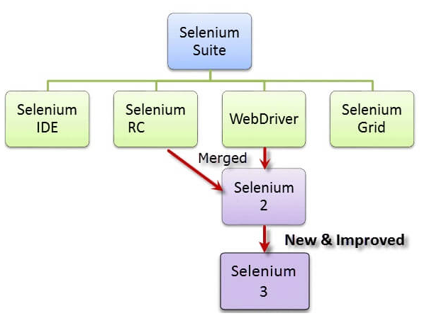
Selenium Suite

Slide 13

Why Selenium as Name?

Slide 14
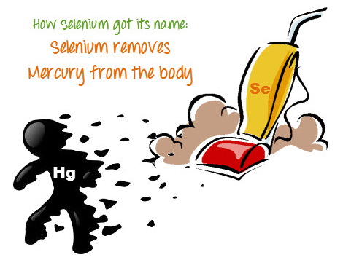

Slide 15

Selenium's WebDriver is now a W3C Recommendation!
This means that many other projects around the world will be able to use WebDriver knowing that it's been vetted by a thorough, multi-stakeholder process and found to be the best and most interoperable tool for browser automation

Slide 16
Using Selenium Web Driver

Slide 17
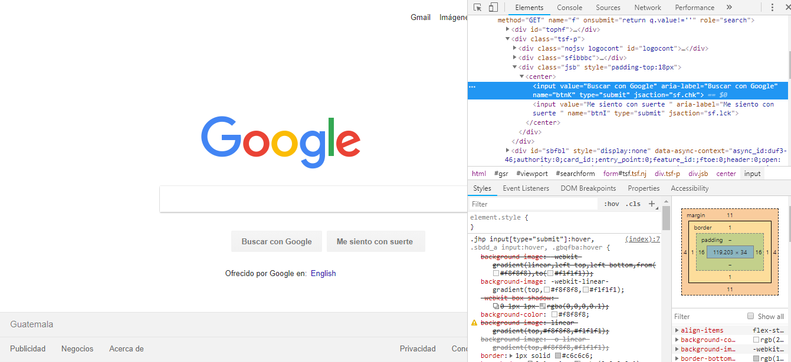

Slide 18
Find Elements
Locator Strategy can by any of the following values.
ID
Name
Class Name
Tag Name
Link Text
Partial Link Text
CSS Selector
XPATH

Slide 19
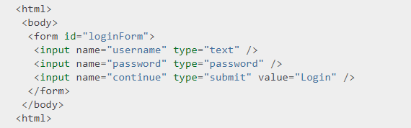
Locator By Id
Driver.findElement(By.Id(“loginForm”))

Slide 20
Locator By Name
username = Driver.findElement(By.name(“username”))
Password = Driver.findElement(By.name(“password”))

Slide 21
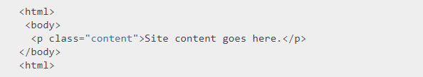
Locator By Class Name
Content = Driver.findElement(By.className(“content”))

Slide 22
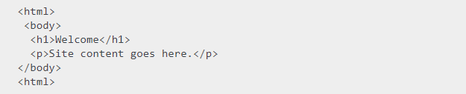
Locator By Tag Name
heading1 = Driver.findElement(By.tagName(“h1”)

Slide 23
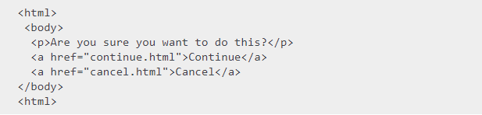
Locator By LinkText and PartialLinkText
continueLink= Driver.findElement(By.linkText(“continue”))
continueLink = Driver.findElement(By.partialLinkText(“conti”))

Slide 24
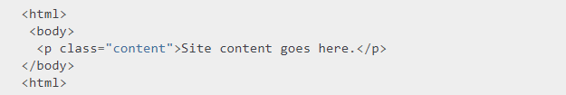
Locator By CSS selector
Content = Driver.findElement(By.cssSelector(“p.content”))

Slide 25
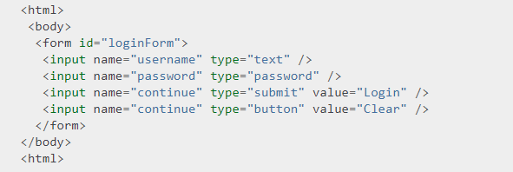
Locator By XPath
userName = Driver.findElement(By.XPath(“//input[@name='username']”))

Slide 26
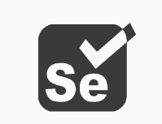



What do I need to start?
Selenium
Java
IntelliJ (or another IDE)
Driver

Slide 27
What is the driver?
Is a separate executable that WebDriver uses to control Browser

Slide 28
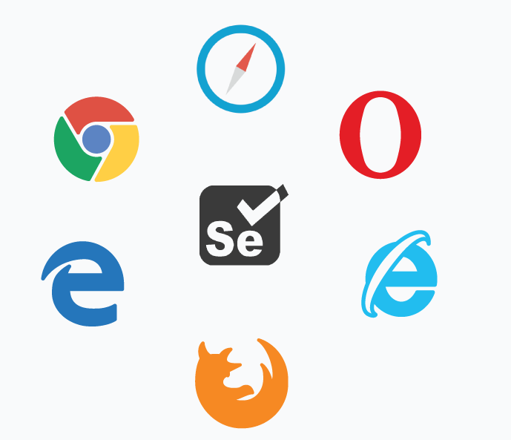
That means that each browser has its own driver

Slide 29
Drivers most used
ChromeDriver
GeckoDriver
InternetExplorerDriver
SafaryDriver

Slide 30
Example (Version 1)

Slide 31

What could we improve?

Slide 32
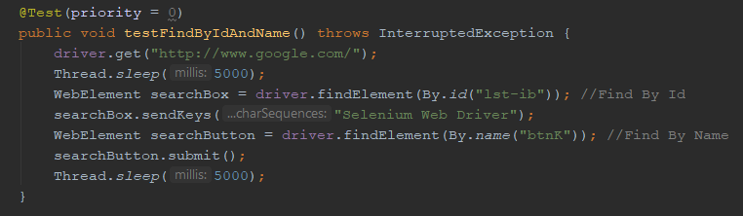

Slide 33
We must not use Thread.Sleep(), Why ?

Slide 34

Selenium Web Drivers Waits
Implicit Wait
Explicit Wait

Slide 35
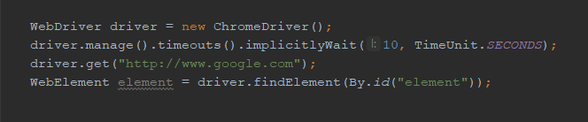
Implicit Wait
Selenium that we would like it to wait for a certain amount of time before throwing an exception that it cannot find the element on the page ("No Such Element Exception“).

Slide 36
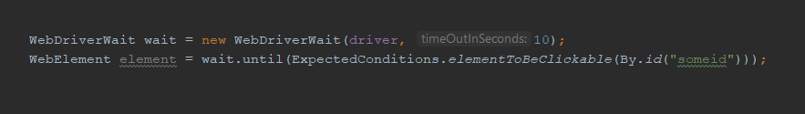
Explicit Wait
It is more extendible in the means that you can set it up to wait for any condition you might like. Usually, you can use some of the prebuilt ExpectedConditions to wait for elements to become clickable, visible, invisible, etc.

Slide 37
Some Expected Conditions For Explicit Wait
VisibilityOf
ElementTobeClickable
NumberOfElementsToBe
PresenceOfElementLocated

Slide 38
Example (Version 2)

Slide 39
What could we improve?

Slide 40
Implement a design pattern
Page Object Model(POM) is a design pattern to create Object Repository for web UI elements.

Slide 41
Under this model, for each web page in the application, there should be corresponding page class.
This Page class will find the WebElements of that web page and also contains Page methods which perform operations on those WebElements.
Name of these methods should be given as per the task they are performing, i.e., if a loader is waiting for the payment gateway to appear, POM method name can be waitForPaymentScreenDisplay().

Slide 42
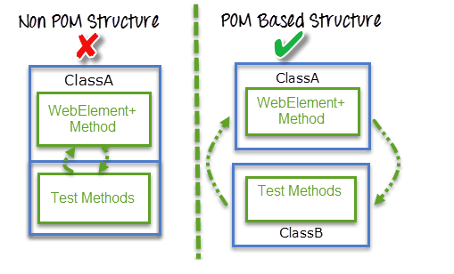

Slide 43
Example (Version 3)

Slide 44
What could we improve?

Slide 45
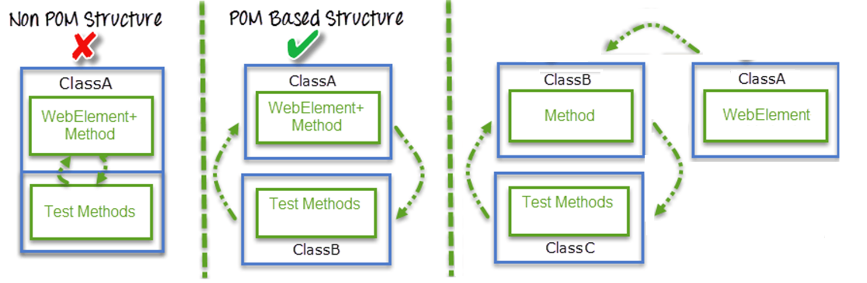
Separate methods from webElements

Slide 46
Example (Version 4)

Slide 47

Questions?

Slide 48
Thanks for your time

Slide 49

Next Meetup
David Mencos
October 24, 2018

Slide 50
Announcements

Slide 51
When: October 4, 2018 Time: 18:15 Where: Sophos Library – Fontabella By: Pedro Ruiz
Agile is not just Scrum
Free admission

Slide 52
ADIG Asociación de Informatica de Guatemala

Slide 53
Thanks.

